Slide 1


Freelancing Earning & Job Trends Insights
Name : Samar Balousha
Tutor : Ameer Al-Halewani
Mentor : Ammar Alnatour
[Presenter Name], Tutor and Mentor
Notes:
Hello everyone, This is Samar Balousha , in this analysis project , 'Freelancing Earning & Job Trends Insights,' is driven by a simple yet critical mission: to enable strategic decision-making across the global freelancing landscape. We are focusing on two key pillars: Earnings Efficiency and Client Loyalty."

Slide 2
Goals
Enable strategic decision-making by identifying the key drivers of Earnings Efficiency and Client Loyalty across global freelancing markets.
  Monitor overall performance and market distribution metrics.
  Quantify the impact of client rating and experience on retention rates.
  Optimize marketing spend by identifying platforms with the highest ROI
  Determine the relationship between platform choice, experience, and hourly pay.
Notes:
Our project goal is clear: To enable strategic decision-making by identifying the key drivers of Earnings Efficiency and Client Loyalty across the global freelance market.

Slide 3
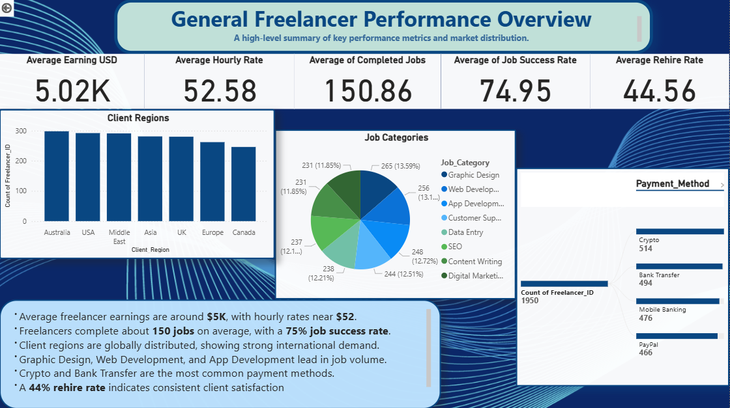
Notes:
This dashboard provides our executive summary. Our average earnings are around $5K, with a healthy 75% job success rate. The work is globally distributed, showing strong international demand. Our overall Rehire Rate is 44%, indicating consistent client satisfaction.

Slide 4
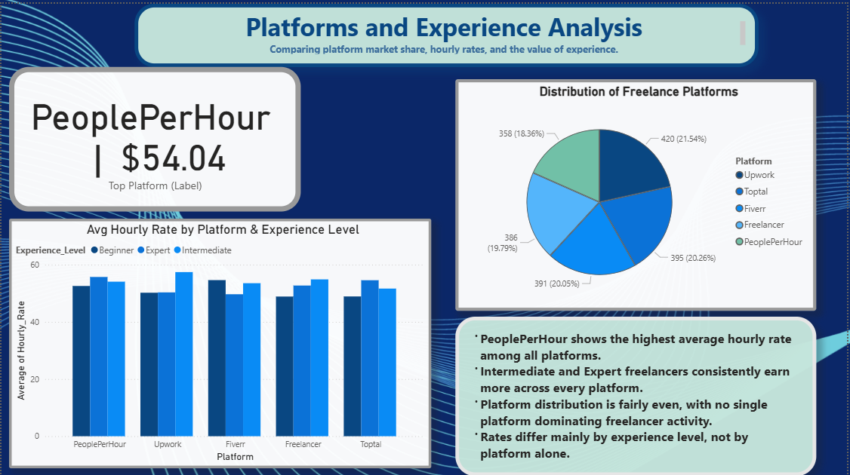
Notes:
This dashboard shows us where freelancers earn their money.
The main takeaway is simple: Experience is the biggest factor, not the platform.
If you look at the bar chart, Expert freelancers earn significantly more than Beginners on every single website.
While PeoplePerHour has the highest hourly rate at $54, the market share is fairly even across all platforms.
In short: Invest in skill development to reach the Expert level—that is the key to higher pay.

Slide 5
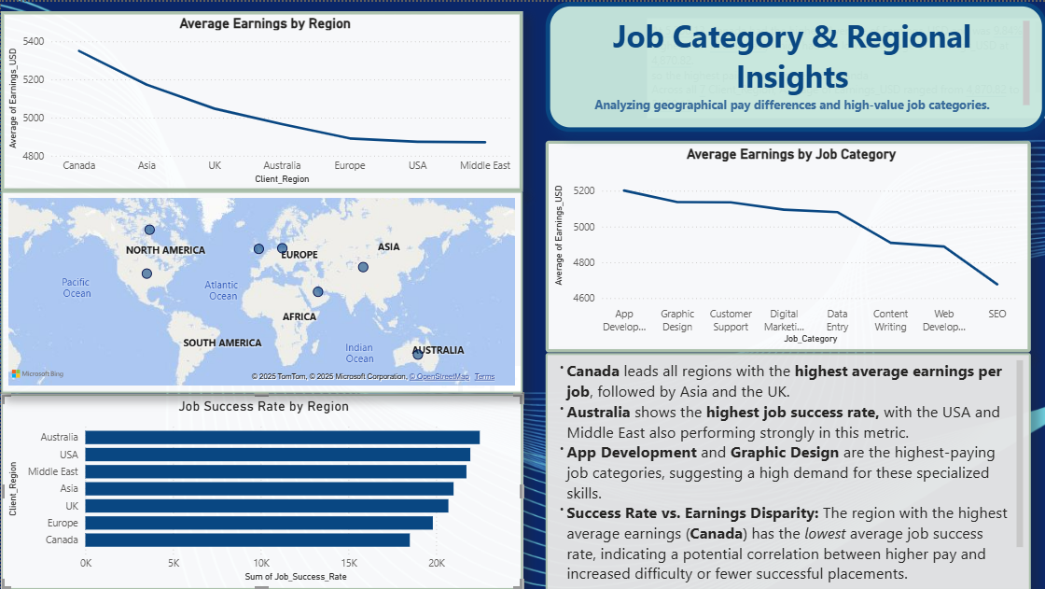
Notes:
This dashboard helps us find high-value markets. Canada pays the highest average earnings, while Australia shows the highest job success rate. By category, App Development and Graphic Design are the clear top earners. This tells us where to concentrate our recruitment and client targeting efforts.

Slide 6
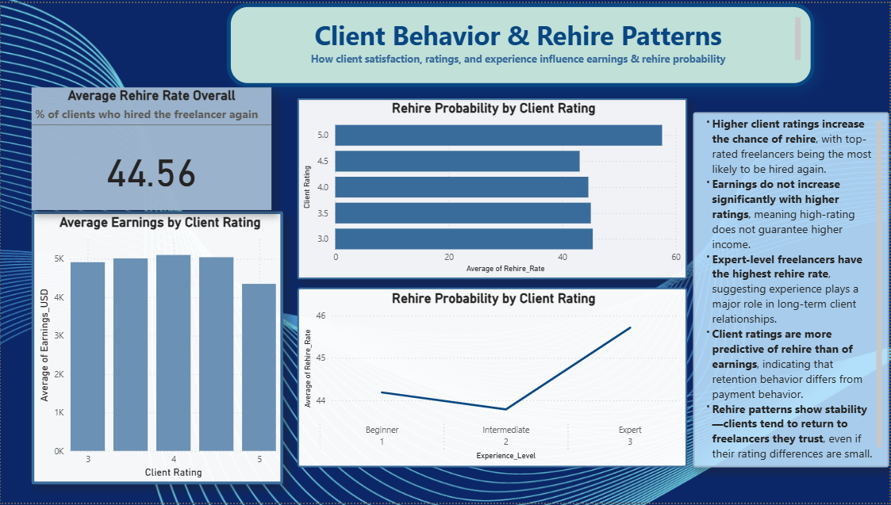
Notes:
This dashboard analyzes client loyalty. Our key finding is that expertise is the strongest driver of rehire, with Experts having the highest rehire rate.
However, there is a loyalty gap. High client ratings do not guarantee high loyalty, and earnings are not significantly affected by high client ratings.
Action: We must focus on targeted retention efforts to secure loyalty from those top-rated clients who currently don't rehire

Slide 7
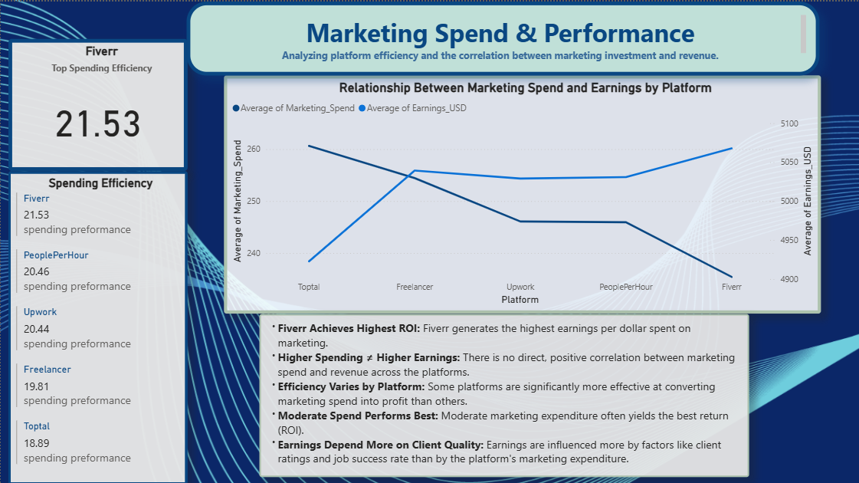
Notes:
For this dashboard the question arise : Are we spending our marketing budget effectively?
The chart clearly shows that there is no direct, positive correlation between spending and earnings. In fact, we see an inverted relationship: high spending does not guarantee high revenue.
The solution lies in Spending Efficiency. Fiverr achieves the highest ROI—it generates the most earnings per dollar spent on marketing. Conversely, Toptal is the least efficient.
Therefore, our immediate action is to reallocate marketing funds based on this efficiency metric, shifting investment away from high-spend, low-return platforms."

Slide 8
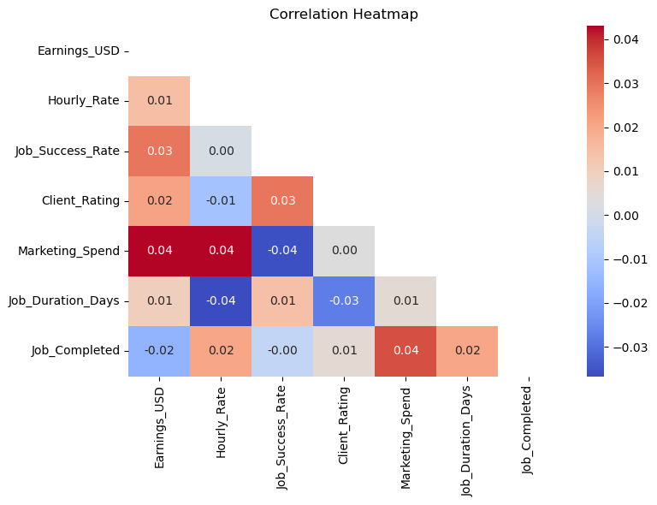
Linear Correlation Analysis of Numerical Features
Are quantitative factors directly related to Earning?
📊 Summary of Correlation Strength * Overall Correlation is Very Weak: All linear relationships between Earnings_USD and the other variables are extremely weak, with correlation values close to zero (around $\pm 0.04$). * Negligible Highest Positive Correlation: The highest positive correlation was found with Marketing_Spend at $+0.04$, which is still too weak for reliable linear prediction. * No Strong Independent Feature Correlation: There are no strong correlations among the independent features themselves (no multicollinearity), suggesting the features are largely independent of one another.
Notes:
This slide shows the correlation between Earnings and all numerical features.
The key insight is that all correlations are extremely weak — almost zero — meaning none of the numeric factors have a meaningful linear relationship with Earnings. Even the highest correlation, Marketing Spend at +0.04, is too small to matter.
We also don’t see multicollinearity, so the features are independent.
Overall, this tells us linear models won’t be very predictive here, and we need more advanced or non-linear models to understand earnings behavior.

Slide 9
SWOT Analysis
S
O
T
W
Strength
Weakness
Opportunities
Threats
High overall Job Success Rate (~75%) and a strong Rehire Rate (44.56%) demonstrate high general client satisfaction.
Failure to monetize high ratings: Top-rated clients (5.0) show lower loyalty, and earnings are flat across all client rating tiers.
High-Wage Category Growth: Focus recruitment efforts on App Development and Graphic Design to significantly boost average earnings.
Inefficient Marketing Spend: Marketing investment on certain platforms does not generate proportional returns, posing a threat of wasted budget.
Notes:
This SWOT analysis highlights four key points:
Our strength is a high job success rate and strong client satisfaction.
The weakness is that even top ratings don’t translate into higher earnings.
The opportunity lies in focusing on high-paying fields like App Development and Graphic Design to boost revenue.
And the main threat is inefficient marketing spend, where investment isn’t generating proportional returns

Slide 10
Recommendations & Strategic Actions
Implement ROI-Driven Marketing Allocation. Re-allocate spending based on the Spending Efficiency metric, reducing investment in low-return platforms (e.g., Toptal) and increasing focus on high-efficiency channels (e.g., Fiverr).
Launch an Expert Acquisition Program. Focus recruitment efforts exclusively on Expert-level talent in high-value categories (App Development & Graphic Design) as they are the key drivers of both earnings and client loyalty.
Enhance Top-Tier Client Retention Strategy. Target high-rated clients (4.5+) with personalized campaigns to boost rehire rates, addressing the unexpected loyalty gap identified in the 5.0-rated customer segment.
Prioritize High-Value Geographic Markets. Direct sales and client outreach efforts towards Canada for maximum project value and Australia to leverage the highest project success rates.
Notes:
Based on the analysis, we recommend shifting marketing spend toward platforms that deliver higher returns, and reducing investment in low-performing ones.
We should also focus on attracting expert-level freelancers in high-earning categories like app development and graphic design.
Additionally, improving retention for top-rated clients can increase repeat business.
Finally, prioritizing strong geographic markets such as Canada and Australia will help capture higher-value projects.

Slide 11
Tools Used & Methodology
Power BI: Used for data integration, cleaning, modeling, and creating interactive, high-impact data visualizations (Dashboards).
Excel: Utilized for initial data review, preliminary cleaning, and transformation tasks.
Python: Employed for advanced statistical analysis, including generating the Heatmap to visualize correlations.
Data Source: Kaggle Dataset
Methodology Summary : Data was collected, cleaned, and organized using Power BI, followed by visual analysis to identify strategic insights and advanced statistical modeling to quantify key performance drivers.
GitHub: GitHub Project
Samar’s LinkedIn
Notes:
For this project, I’ve used

Slide 12
Acknowledgments and Thank You
”Quality and Efficiency Drive the Future”
Special thanks to: Paper Airplanes Organization and the Women in Tech Program for their support and opportunity.
Mentor & Tutor Appreciation: Sincere gratitude to Ameer Al- Halwani and Ammar Alnatour for continuous guidance and expertise
Thank you for your time and attention.

